Slide 1
Linux System
PASS
Lab Assignment
Email: chitram2@pdx.edu

Slide 2
Instructions: Make a copy of this document, place the copy into your submissions folder, fill it with your responses and include a link to it when you submit via the lab assignment submission form. If you work on this with a partner then include your partner’s email address in the assignment submission form and on the title page of this document.
With each question, use the space on the slide to show your response. Add additional slides as needed.
Paste images into the document as needed.
Use the Assignment Submission Form to submit your completed assignment

Slide 3
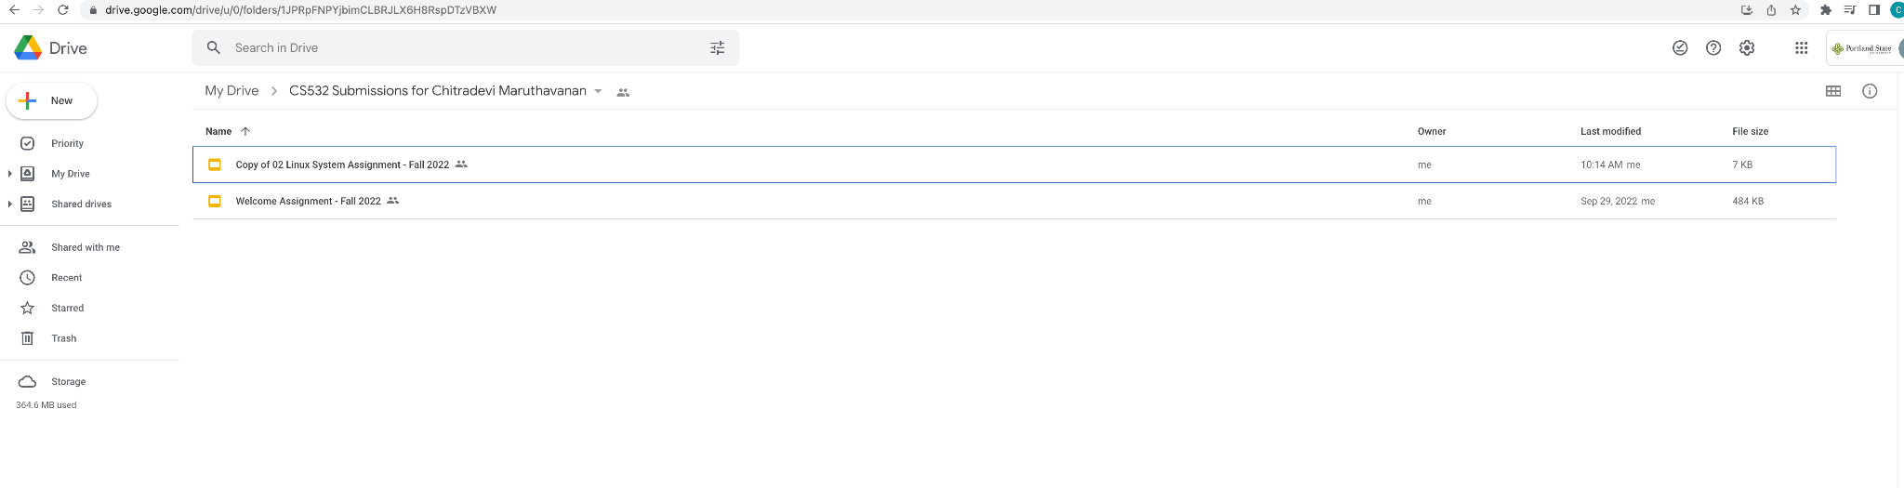

Slide 4
1. login to linux.cs.pdx.edu using ssh <userid>@linux.cs.pdx.edu
If you are unable to login then first read the useful documentation at https://cat.pdx.edu/2021/09/20/remote-access-to-mcecs-computer-labs-fall-2021/
After reading the documentation, if you are still unable to login then contact CAT by sending an email to support@cat.pdx.edu

Slide 5
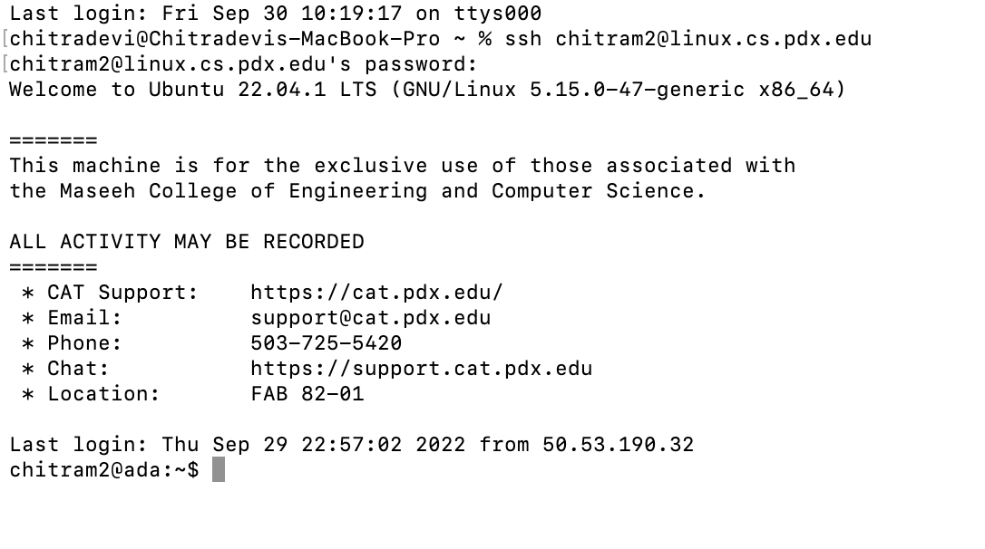

Slide 6
2. ssh to linux.cs.pdx.edu and then create a CS532 directory. Use the mkdir command to create your new directory. To find out more about the mkdir command or any Linux command, use the man command, like this:
man mkdir
if you don’t like the name ‘CS532’ then choose a different name. In general we will not need to find or access this directory, so you are free to name it anything you like.
After you create the directory, use the cd command to move to your new CS532 directory. Use the ls command verify that the directory is empty.

Slide 7
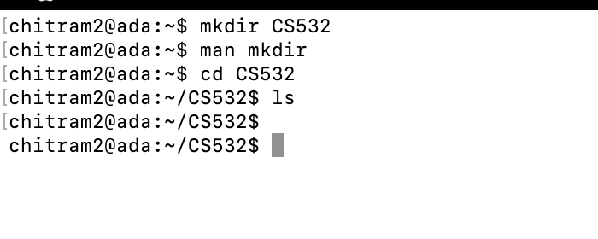

Slide 8
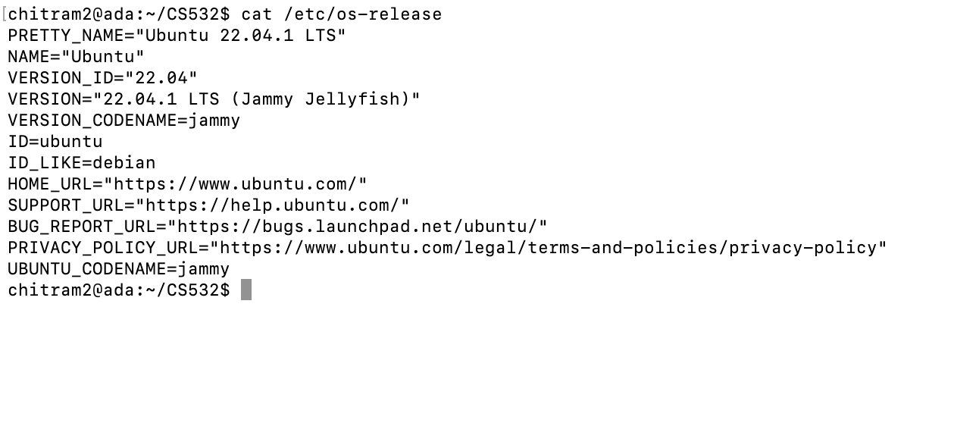
3. What type of Linux distribution is running on linux.cs.pdx.edu? And which version of that distribution?
You can find information about the host’s Linux distribution and version by printing out the /etc/os-release file, like this: cat /etc/os-release

Slide 9
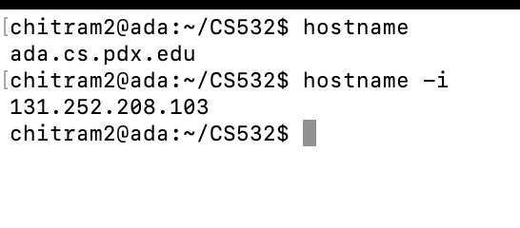
4. We call it linux.cs.pdx.edu but that is not the real name of the host. What is the real name of the host? To find this, try the hostname command.

Slide 10
5. (optional) Configure SSH Keys
Every time you login to linux.cs.pdx.edu with ssh you are prompted for your password. This is a pain and is mostly a waste of time if you always login from the same trusted laptop or desktop computer.
A more convenient way to do it is to configure SSH Keys so that your client (your laptop or desktop) becomes trusted so that you can login without a password. You can configure this with SSH Keys.
See this tutorial for more information about how to configure SSH Keys for a linux server such as linux.cs.pdx.edu: link
This is optional; you can skip this step if not interested

